Slide 1








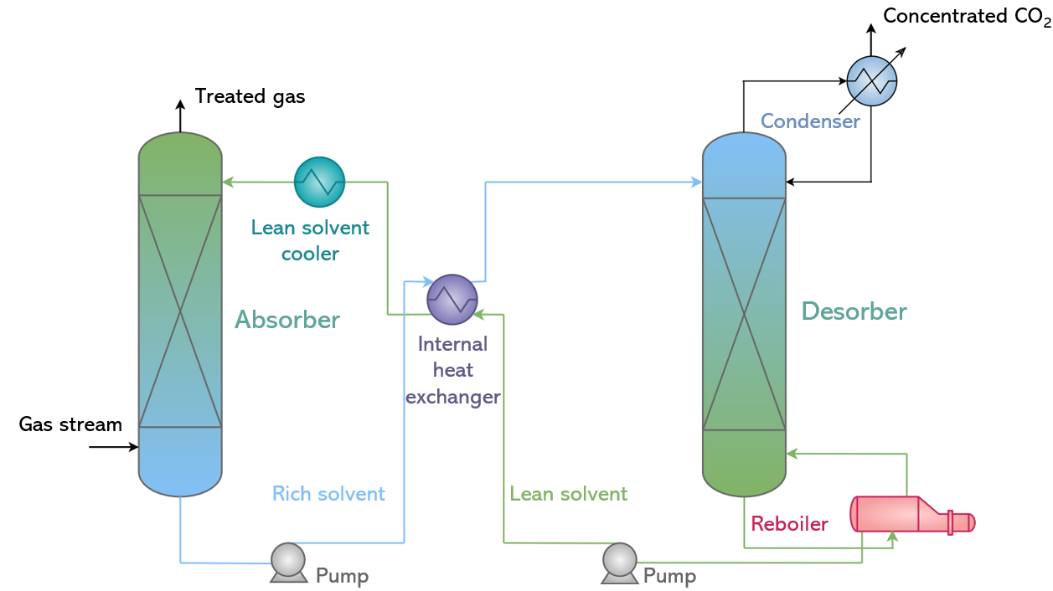




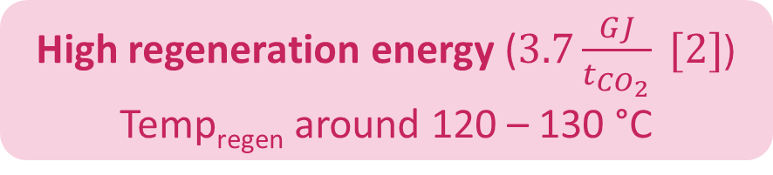
Selection of catalysts for the regeneration step in an amine-based absorption-regeneration CO₂ capture process
Célia PASTE (celia.paste@umons.ac.be), Lionel DUBOIS and Diane THOMAS
Chemical and Biochemical Process Engineering Unit, Faculty of Engineering, University of Mons, 20 Place du Parc, 7000 Mons, Belgium
Context of the study
CO₂ emissions
CO₂ capture
CO₂ Utilisation or Storage
Total worldwide CO₂ emissions (1990 – 2021) [1]
Fuel and biofuel
Absorption
Adsorption
Membrane technology
Chemicals
36.7 Gt in 2021
Micro-algae
Polymers
Cryogenics
etc…
Food processing
Conventional amine-based absorption-regeneration process
Geological storage
CO₂ emissions by sector in the world (2021) [1]
etc…
Electricity and heat
Drawback of the process
Transport
High regeneration energy ($3.7\frac{GJ}{t_{CO_{2}}} [2]$)
Temp_{regen} around 120 – 130 °C
Manufacturing and construction
Buildings
Industrial processes
Reduction of energy consumption by:
Land use change and forestry
Innovative solvents
Process optimization
Use of catalysts
Other
Catalyst

Slide 2
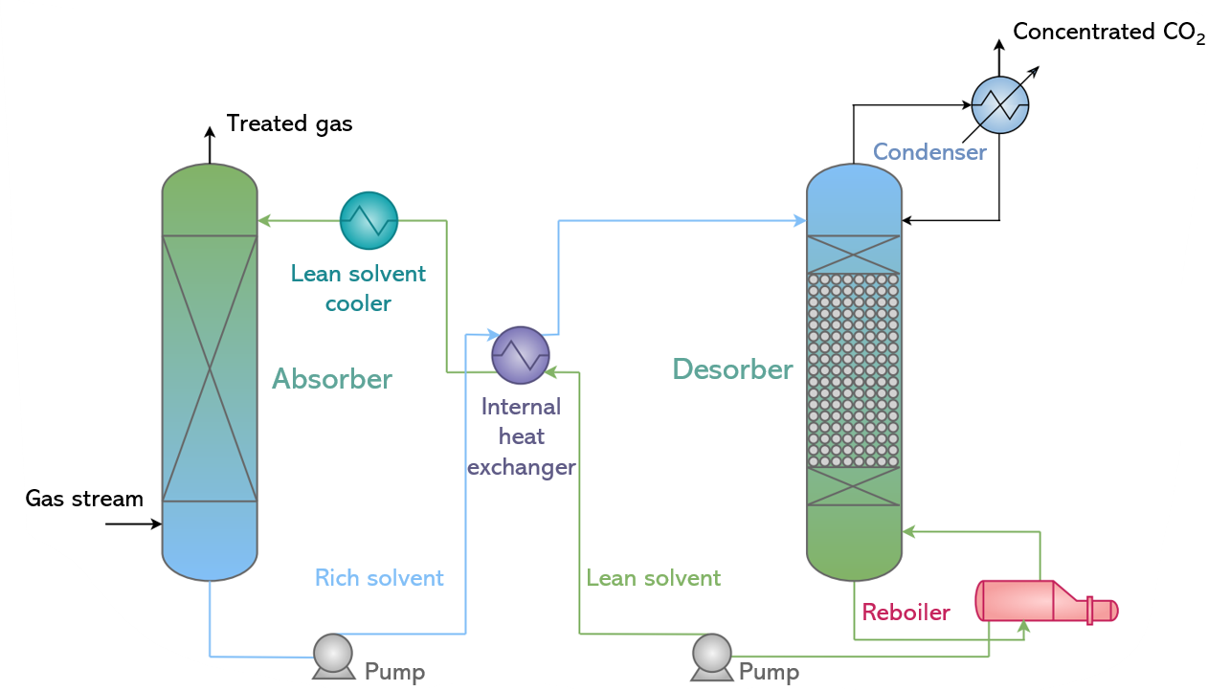
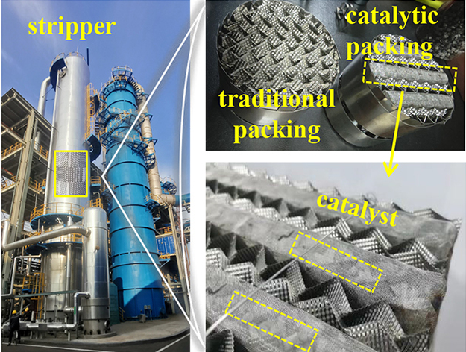
Selection of catalysts for the regeneration step in an amine-based absorption-regeneration CO₂ capture process
Célia PASTE (celia.paste@umons.ac.be), Lionel DUBOIS and Diane THOMAS
Chemical and Biochemical Process Engineering Unit, Faculty of Engineering, University of Mons, 20 Place du Parc, 7000 Mons, Belgium
Context of the study
CO₂ emissions
CO₂ capture
CO₂ Utilisation or Storage
Total worldwide CO₂ emissions (1990 – 2021) [1]
Fuel and biofuel
Absorption
Adsorption
Membrane technology
Chemicals
36.7 Gt in 2021
Micro-algae
Polymers
Cryogenics
etc…
Food processing
Conventional amine-based absorption-regeneration process
Geological storage
CO₂ emissions by sector in the world (2021) [1]
etc…
Electricity and heat
Use of catalysts
Transport
Manufacturing and construction
Buildings
Industrial processes
Land use change and forestry
Other
Image from: [3]

Slide 3
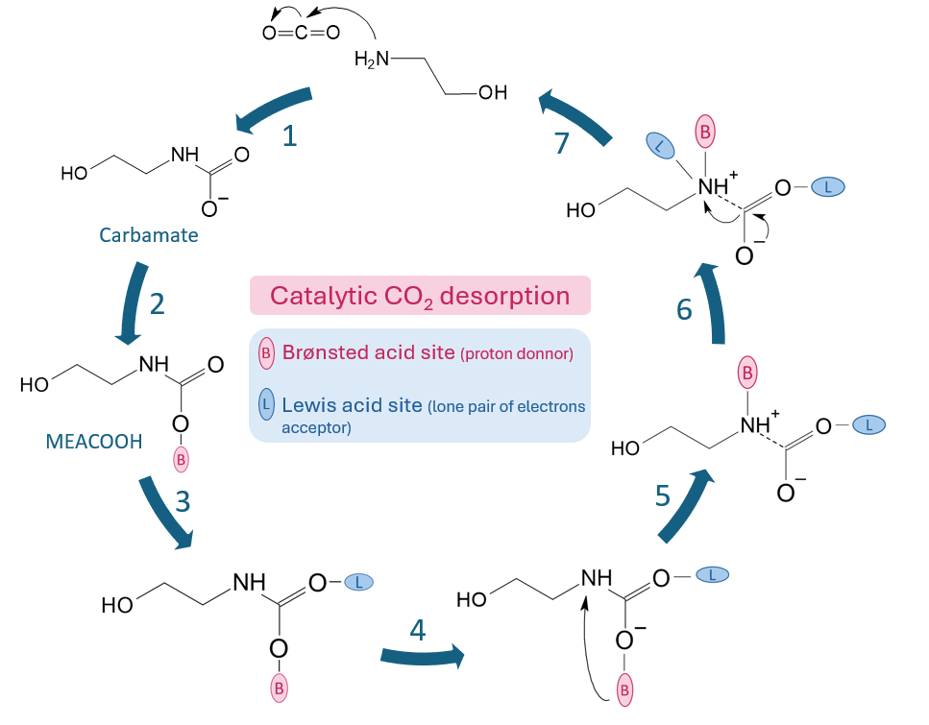





Cyclic catalytic mechanism of CO₂ desorption
Selection of catalysts for
amine-based solvent regeneration
7 steps of catalytic desorption of CO₂ from MEA
4 main categories
METAL OXIDES
NATURAL CLAYS
Carbamate formation
$CO_{2}+2MEA ⇌MEACOO^{−}(carbamate)+ {MEAH}^{+}$
Proton acceptance from a Brønsted acid site
Chemisorption of MEACOOH on the catalyst surface (Oxygen binds to a Lewis acid site)
Proton transfer from Oxygen to Nitrogen
Nitrogen-Oxygen bond stretch
N-C bond breakage due to a 2nd Lewis acid site on the Nitrogen
Separation and desorption of CO₂
MoO₃
V₂O₅
Cr₂O₃
TiO₂
WO₃
ZnO
ZrO₂
Nb₂O₅
Ag₂O
NiO
CuO
MnO₂
γ-Al₂O₃
Attapulgite
Montmorillonite
ZEOLITES
H-ZSM5
H-Y
H-Mordenite
H-Beta
SAPO-34
MESOPOROUS SILICAS
MCM-41
SBA-15
KIT-6
Enhance CO₂ desorption
23 catalysts to study
Based on [4]
4 criteria
Increase in CO₂ desorption kinetics
1. Physicochemical properties
2. Performances based on literature data
Without catalyst (5M MEA)
Increase in the amount of CO₂ desorbed (%) = $\frac{A_{2}−A_{1}}{A_{1}}.$100
With catalyst (5M MEA)
A₂
similar operating conditions
for a same amount of energy supplied to the system
3. Economic
criterion
4. Safety
criterion
A₁
Which catalyst to use ?

Slide 4

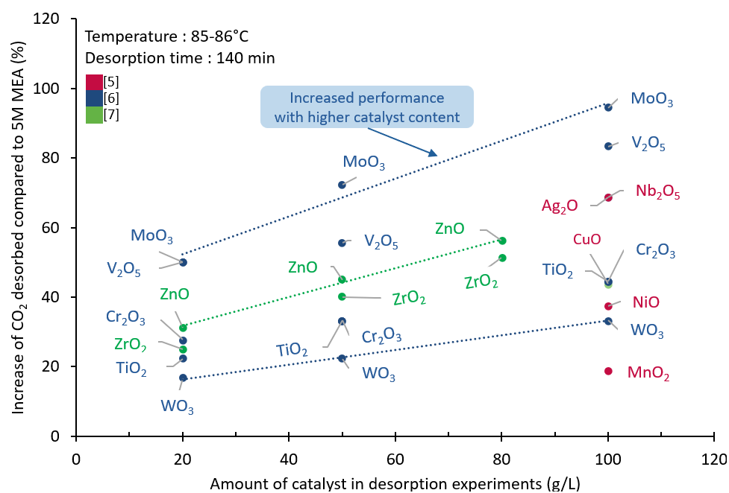




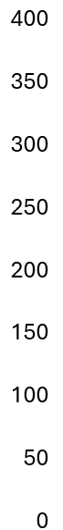
Selection of catalysts for amine-based solvent regeneration: 4 criteria
1. Physicochemical properties
2. Performances at lab scale from literature
Chemical properties
Metal oxides
Zeolites, mesoporous silicas and natural clays
Brønsted Acid Site (BAS) (proton donors)
Difficult to compare catalysts between studies because of different operating conditions:
Lewis Acid Site (LAS) (lone pair of electrons acceptors)
Desorption temperature
The catalyst must have a maximum of number BAS and LAS
Desorption time
Catalyst concentration
Physical properties
Solvent
A large mesoporous surface area is necessary to allow chemical species to reach the catalytic sites.
Compare the catalysts against a reference catalyst widely used in studies: H-ZSM5 (zeolite).
Grain of catalyst
NB: KIT-6, attapulgite and montmorillonite could not be compared with H-ZSM5 (data not available)
3. Economic criterion
4. Safety criterion
Selected catalysts
Hazard statements very striking
METAL OXIDES
Metal oxides
Mesoporous silicas
H330: Fatal if inhaled (V₂O₅)
5 of 13 selected
H350: May cause cancer (V₂O₅)
MoO₃
Cr₂O₃
ZrO₂
Nb₂O₅
γ-Al₂O₃
H350i: May cause cancer by inhalation (NiO)
Zeolites
Natural clays
H362: May cause harm to breast-fed children (V₂O₅)
H372: Cause damage to organs to prolonged or repeated exposure (V₂O₅ and NiO)
ZEOLITES
3 of 5 selected
H-ZSM5
H-Mordenite
H-Beta
Reference: H-ZSM5
Reference: H-ZSM5
H410: Very toxic to aquatic life with long lasting effects (CuO and ZnO)
1
1
1
Catalysts V₂O₅ NiO, CuO and ZnO have been eliminated from the selection process
TiO₂
Cr₂O₃
ZrO₂
MnO₂
V₂O₅
ZnO
NiO
CuO
WO₃
H-Y
KIT-6
8 selected catalysts
γ-Al₂O₃
Ag₂O
H-ZSM5
MoO₃
Nb₂O₅
H-Beta
H-ZSM5
Montmo
-rillonite
SAPO-34
SBA-15
Atta
-pulgite
H-Mordenite
MCM-41

Slide 5
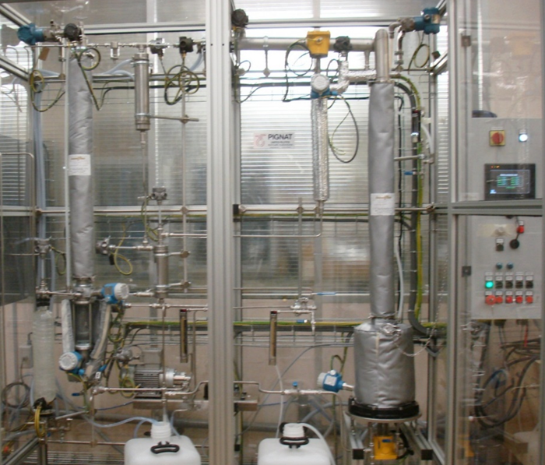
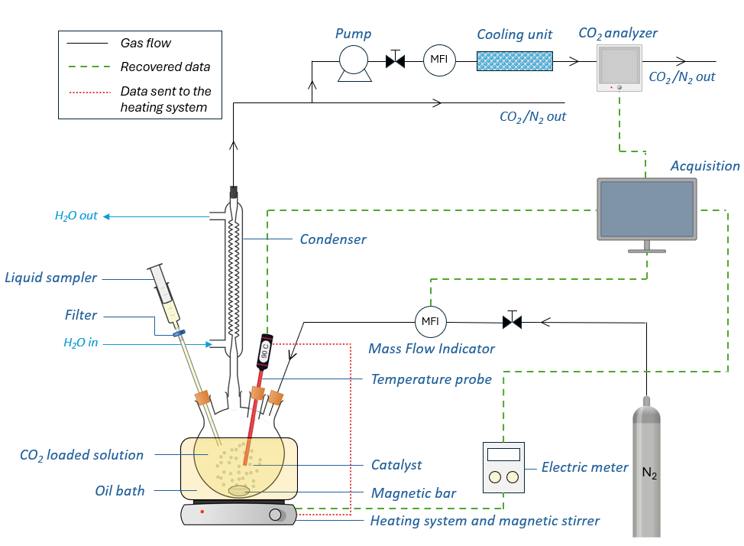


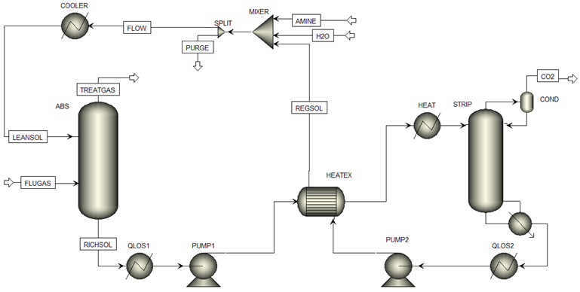



Conclusion and prospects
Lab-scale experiments
Project overview
Micro-pilot experiments
1. CO₂ loading of amine-based solvent
2. Solvent regeneration with gas and liquid analyses
3. Comparison of catalysts
Bibliographic review
  Understanding the role of the catalyst
  Selection of catalysts
Desorption column with catalyst
Done
2. Regeneration experiments
  Lab-scale tests with powder
  Shaping of catalysts
  Micro-pilot tests with pellets
Micro-pilot simulation flowsheet
In progress…
3. Simulations
  Validation of micro-pilot tests
  Larger-scale simulation of the most promising case
To be done
References and Acknowlegdments
[1] Climate Watch, Historical GHG Emissions [Internet]. [cited 2024 Sep 16].
Available from: https://www.climatewatchdata.org/ghg-emissions?end_year=2021&start_year=1990
[2] T. Nakagaki, I. Tanaka, Y. Furukawa, H. Sato, and Y. Yamanaka, “Experimental evaluation of effect of oxidative degradation of aqueous monoethanolamine on heat of CO2 absorption, vapor liquid equilibrium and CO2 absorption rate,” in Energy Procedia, Elsevier Ltd, 2014, pp. 2384–2393. doi: 10.1016/j.egypro.2014.11.260.
[3] L. Xing, Z. Chen, G. Zhan, Z. Huang, L. Wang, and J. Li, “Efficient CO2 Desorption Catalysts: from Material Design to Kinetics Analysis and Application Evaluation,” Engineering, Sep. 2024, doi: 10.1016/j.eng.2024.08.024.
[4] A. H. Bhatti, M. Waris, W. W. Kazmi, K. H. Kang, and U. H. Bhatti, “Acid-treated activated carbon as simple and inexpensive catalyst to accelerate CO₂ desorption from aqueous amine solution,” Carbon Capture Science and Technology, vol. 8, Sep. 2023, doi: 10.1016/j.ccst.2023.100131.
[5] U. H. Bhatti, D. Sivanesan, D. H. Lim, S. C. Nam, S. Park, and I. H. Baek, “Metal oxide catalyst-aided solvent regeneration: A promising method to economize post-combustion CO₂ capture process,” J Taiwan Inst Chem Eng, vol. 93, pp. 150–157, Dec. 2018, doi: 10.1016/j.jtice.2018.05.029.
[6] U. Hassan Bhatti et al., “Effects of Transition Metal Oxide Catalysts on MEA Solvent Regeneration for Post-combustion Carbon Capture Process,” ACS Sustain Chem Eng, 2017, doi: 10.1021/acssuschemeng.7b00604.
[7] U. H. Bhatti, S. Nam, S. Park, and I. H. Baek, “Performance and Mechanism of Metal Oxide Catalyst-Aided Amine Solvent Regeneration,” ACS Sustain Chem Eng, vol. 6, no. 9, pp. 12079–12087, Sep. 2018, doi: 10.1021/acssuschemeng.8b02422.
This work was supported by the Fonds de la Recherche Scientifique-FNRS under Grant T.0218.23 (research project ATLANTIS)

